Slide 1


Social Networking
The Dangers and
How to Protect Yourself

Slide 2
What is Social Networking?

Slide 3
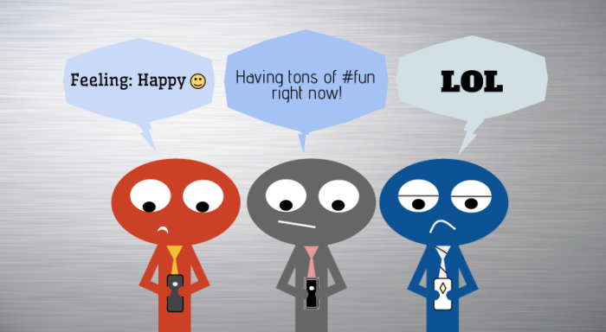

Slide 4
What It Is
The usage of Social Media to interact with
others typically by using:
Pictures
Texts
Videos

Slide 5
72% of all internet users are now active on social media

Slide 6



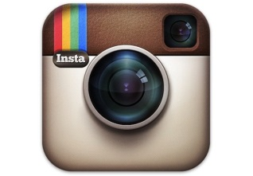





Social Media

Slide 7




Top 5 most Commonly Used
Facebook- 900 000 000 Users
Twitter- 310 000 000 Users
LinkedIn- 255 000 000 Users
Pinterest- 250 000 000 Users

Slide 8
General Statistics
72% of all internet users are now active on social media
18-29 year olds have an 89% usage
The 30-49 bracket sits at 72%

Slide 9
General Statistics
60% of 50 to 60 year olds are active on social media
In the 65 plus bracket, 43% are using social media
71% of users access social media from a mobile device.

Slide 10
The Dangers

Slide 11
Identity Theft
Personal Information is available through Social Media
Gives others information to help them hack accounts.

Slide 12
Computer or Social Profile Hacking

Slide 13
Stalking

Slide 14
Burgalars

Slide 15
